Slide 1


GROUP 2: CLIMATE
Probabilistic Forecasting of Extreme Weather Events
Shlok Shah
Abhi Jain
Dhruti Kobawala
Prarthana Gajera
Pearl Patel

Slide 2
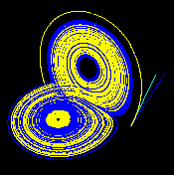
Project Context and Motivation
Title: Probabilistic Modeling of Extreme Weather Events for Risk-Informed Decision Support
Traditional forecasts provide a single predicted value.
Extreme weather events like heavy rainfall, storms are rare but high impact.
The atmosphere behaves as a chaotic dynamical system.
Small errors in initial conditions can grow significantly over time.
Deterministic prediction alone is insufficient for risk-sensitive decisions.
Hence, we adopt a probabilistic framework to reduce the uncertainty.
https://en.wikipedia.org/wiki/Lorenz_system
01/07/19
| 2

Slide 3
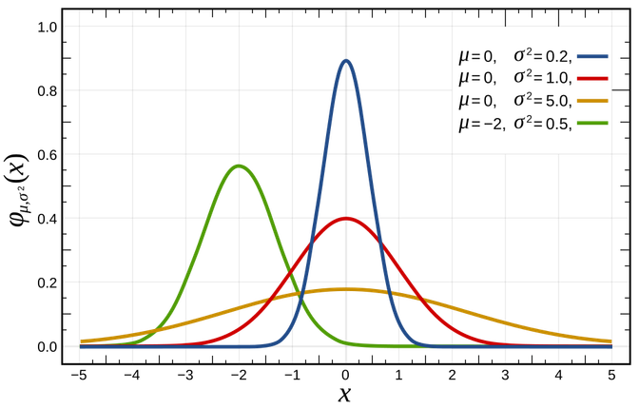
Project Objective and Scope
Objective:- To Estimate the probability of an extreme event exceeding a threshold, P(X>τ), where X represents atmospheric variables and τ is the extreme threshold.
Scope:- • Use ensemble forecasting to capture uncertainty.
Fit probability distributions to model variability.
Define extreme threshold using inverse CDF.
Apply Bayesian inference to estimate event likelihoods.
Provide probabilistic risk output instead of a single forecast.
https://en.wikipedia.org/wiki/Normal_distribution
01/07/19
| 2

Slide 4
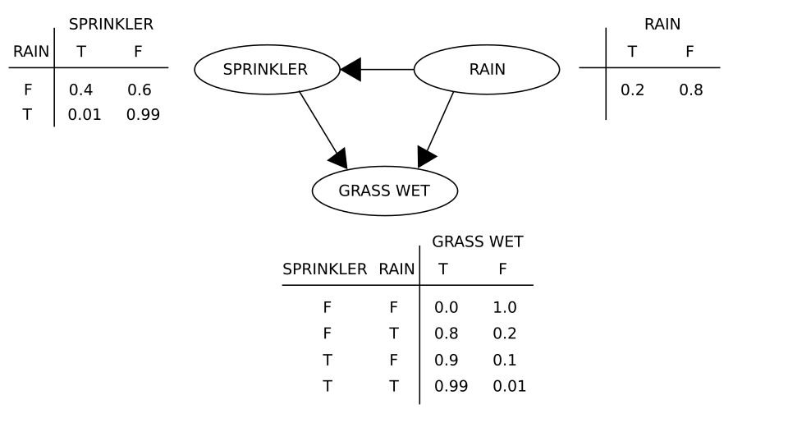
Project System Overview
Our probabilistic pipeline includes:
Collect ensemble and historical data
Model uncertainty using probability distributions
Define extreme threshold τ
Perform Bayesian parameter updating
Aggregate ensemble probabilities
Compute final risk estimate
Final Output:
P(X>τ∣D)
https://en.wikipedia.org/wiki/Bayesian_network
01/07/19
| 2

Slide 5
Sources of Uncertainty
Initial Condition Uncertainty – Imperfect atmospheric measurements
Model Uncertainty – Approximations in physical parameterization
Environmental Variability – Natural randomness in weather evolution
Data Uncertainty – Limited records of extreme events
01/07/19
| 2

Slide 6
Key Random Variables and Their Roles
Notation | Distribution / Role | Interpretation | Variable
X = (H, P, W, R) | Joint dist. f_X(h,p,w,r) Gamma / GEV for rainfall | Core input driving extreme event probability | Atmospheric State
X⁽¹⁾, …, X⁽ᴹ⁾ | Samples from atmospheric distribution; conditionally independent | Represent forecast spread and uncertainty | Ensemble Members
Y ~ Bernoulli(p) | Y = 1 if X > τ, else 0 p = P(X > τ) | Binary outcome: extreme event occurred or not | Extreme Event Indicator
θ (e.g., β in logistic) | Prior: β ~ N(μ, Σ) Posterior via Bayes update | Quantifies parameter uncertainty via Bayesian framework | Model Parameters
ε ~ N(0, σ²ₒ) | Added to convective tendencies φˢᵗᵒᶜʰ = φ̄ + ε | Models sub-grid model error in ensemble members | Stochastic Perturbation
01/07/19
| 2

Slide 7
Probabilistic Models and Assumptions
Bayesian Framework
Ensemble + Distribution Models
Bayes’ Theorem
Ensemble Aggregation:
P(θ | D) = P(D | θ) · P(θ) / P(D)
P(E) = Σ wᵢ · P(E | Mᵢ) where Σ wᵢ = 1
Posterior Predictive:
PDF/CDF for threshold:
P(X_future > τ | D) = ∫ P(X > τ | θ) · P(θ|D) dθ
f(x) = d/dx F(x)
F(x) = P(X ≤ x)
τ = F⁻¹(1 − α)
Extreme Indicator:
P(Y=1 | X) = 1 / [1 + exp(−(β₀ + βᵀX))]
Empirical Estimator
p̂ = (1/n) Σ I(Xᵢ > τ)
Prior:
Fitted Distributions:
β ~ Normal(μ, Σ)
Normal, Gamma, Lognormal, GEV
01/07/19
| 2

Slide 8
Probabilistic Reasoning and Inference Logic
1
Ensemble Spread
2
Fit Distribution
3
Set Threshold τ
X⁽¹⁾,...,X⁽ᴹ⁾ represent plausible atmospheric states. Spread = uncertainty signal.
Fit GEV/Gamma to ensemble outputs. Estimate parameters θ via MLE or Bayesian posterior.
τ = F⁻¹(1−α) at α = 0.05 or 0.01. Defines the extreme event region X > τ.
4
Aggregate Ensemble
Bayesian Update
5
6
Risk Output
P(θ|D) ∝ P(D|θ)·P(θ)
MCMC sampling generates posterior estimates of θ.
P(X>τ|D) produced with confidence bounds via Hoeffding's Inequality. Feeds risk-based decisions.
P(E) = Σ wᵢ·P(E|Mᵢ)
Bayesian weights assigned based on posterior model probability.
01/07/19
| 2

Slide 9

Operationalizing Probabilistic Reasoning in the Project
Ensemble Samples
Fit Distribution and Plot PDF/CDF
Bayesian Posterior Update
MonteCarlo Estimation
Treat M ensemble forecast outputs as M random samples from the atmospheric distribution.
Fit Normal, Gamma, or GEV to ensemble outputs. Plot to observe tail behavior and validate threshold τ.
Update parameter beliefs using observed data via MCMC sampling.
Approximate posterior predictive probability using samples drawn from P(θ | D).
X⁽¹⁾, X⁽²⁾, … , X⁽ᴹ⁾
P(θ | D) ∝ P(D | θ) · P(θ)
P(X>τ|D) ≈ (1/n) Σ I(Xᵢ>τ)
τ = F⁻¹(1 − α)
How we evaluate?
Spread-Skill Relationship
Probability Calibration
Hoeffding's Bound
Larger ensemble spread should correlate with larger forecast error — validates uncertainty estimates.
Predicted probabilities should match observed event frequencies — checked via reliability plots.
P(|p̂ − p| ≥ ε) ≤ 2exp(−2nε²) — statistical guarantee on empirical probability accuracy.
01/07/19
| 2

Slide 10
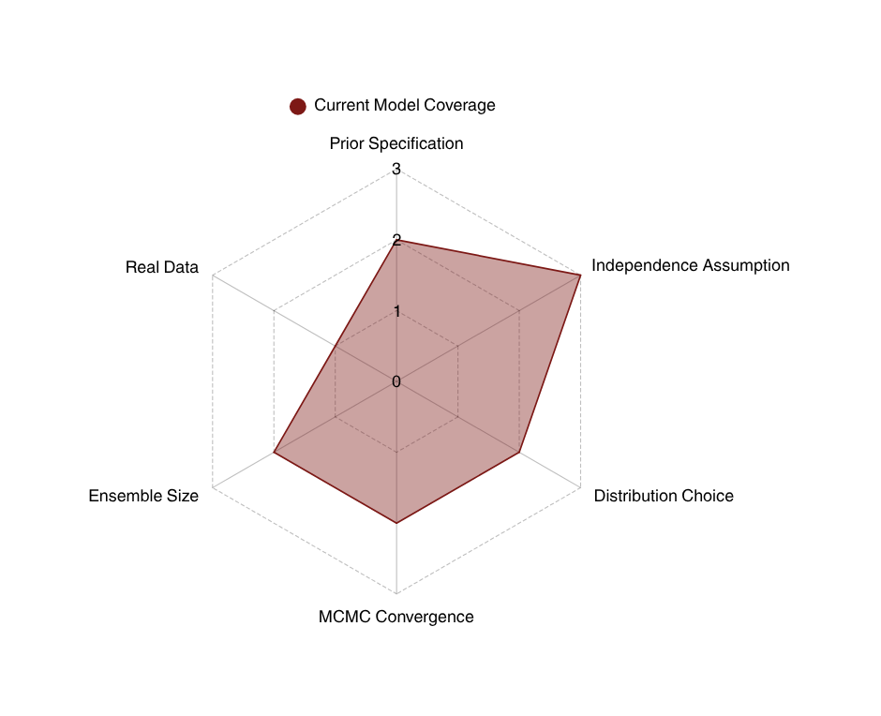
Current Limitations and Conceptual Gaps
1
Prior Specification
2
Independence Assumption
3
Distribution Choice
4
MCMC Convergence
5
Ensemble Size
6
Real Data
01/07/19
| 2

Slide 11
Planned Refinements and Role Coordination
Milestone 3 Refinements
Role Coordination
Github Manager
Calibrate priors
Implement MCMC sampling
Generate PDF/CDF simulation plots
Evaluate spread-skill relationship
Scribes
Video Team
01/07/19
| 2

Slide 12
Summary of Group-Level Understanding
P(X>τ|D): risk-informed output
Ensemble spread - quantifies initial condition & model uncertainty
Bayesian inference - updates probabilities with observed data
Bayesian Ensemble Probabilistic Model
GEV / Gamma distributions - capture extreme tail behavior
Hoeffding bounds - statistical confidence on estimated P(X>τ)
Next: MCMC + PDF/CDF simulations
01/07/19
| 2

Slide 13
THANK YOU!
01/07/19
| 2

